Slide 1


Lecture 9
Produced by Dr. Worldwide
Welcome to the 305
~
~

Slide 2

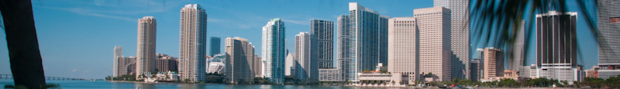
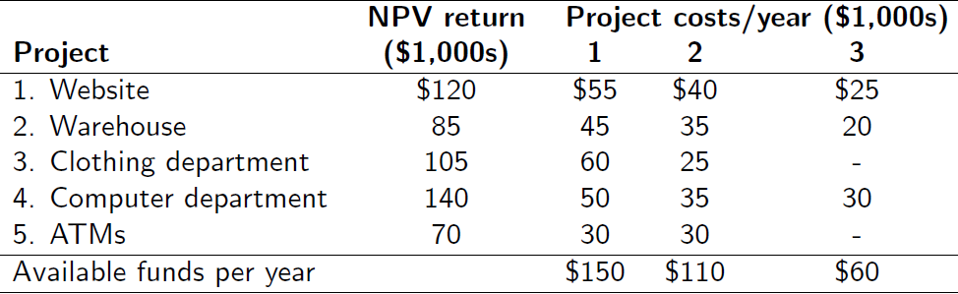
Ex: Capital Budgeting
University bookstore is considering several expansion projects
Some projects require 2-years and some projects require 3 years
Not enough space available for computer and clothing department

Slide 3
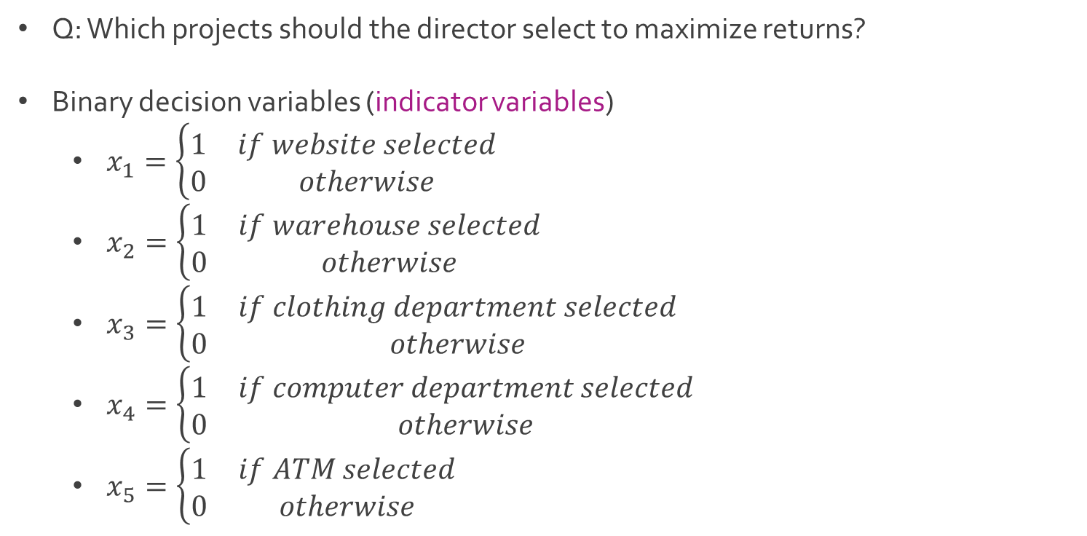
Ex: Capital Budgeting
Q: Which projects should the director select to maximize returns?
Binary decision variables (indicator variables)
$x_{1}=\left\{\begin{matrix}1 & if website selected \\ 0 & otherwise\end{matrix}\right.$
$x_{2}=\left\{\begin{matrix}1 & if warehouse selected \\ 0 & otherwise\end{matrix}\right.$
$x_{3}=\left\{\begin{matrix}1 & if clothing department selected \\ 0 & otherwise\end{matrix}\right.$
$x_{4}=\left\{\begin{matrix}1 & if computer department selected \\ 0 & otherwise\end{matrix}\right.$
$x_{5}=\left\{\begin{matrix}1 & if ATM selected \\ 0 & otherwise\end{matrix}\right.$

Slide 4
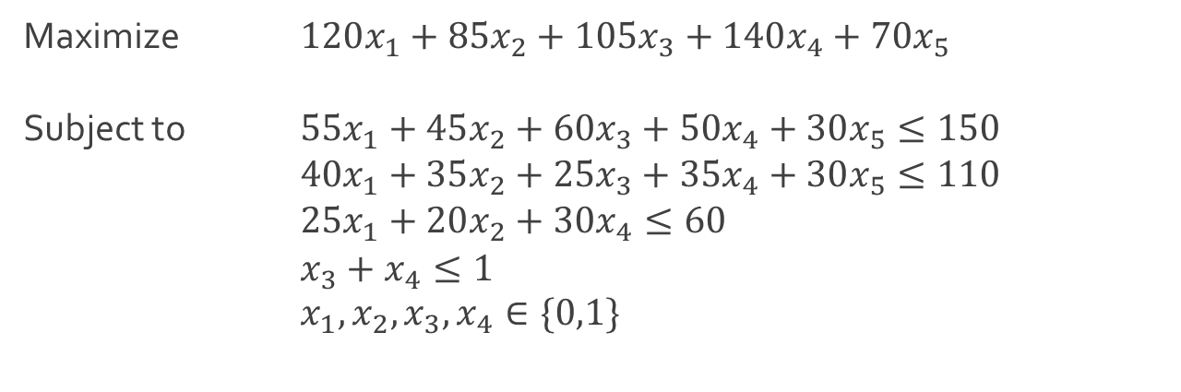
Ex: Capital Budgeting
Linear program in standard form
Decision variables are binary making this a 0-1 Integer Model
Download CapitalBudgeting.xlsx from course website from link Sheet 1
Maximize $120x_{1}+85x_{2}+105x_{3}+140x_{4}+70x_{5}$
Subject to $55x_{1}+45x_{2}+60x_{3}+50x_{4}+30x_{5}≤150$
$40x_{1}+35x_{2}+25x_{3}+35x_{4}+30x_{5}≤110$
$25x_{1}+20x_{2}+30x_{4}≤60$
$x_{3}+x_{4}≤1$
$x_{1},x_{2},x_{3},x_{4}∈\{0,1\}$

Slide 5
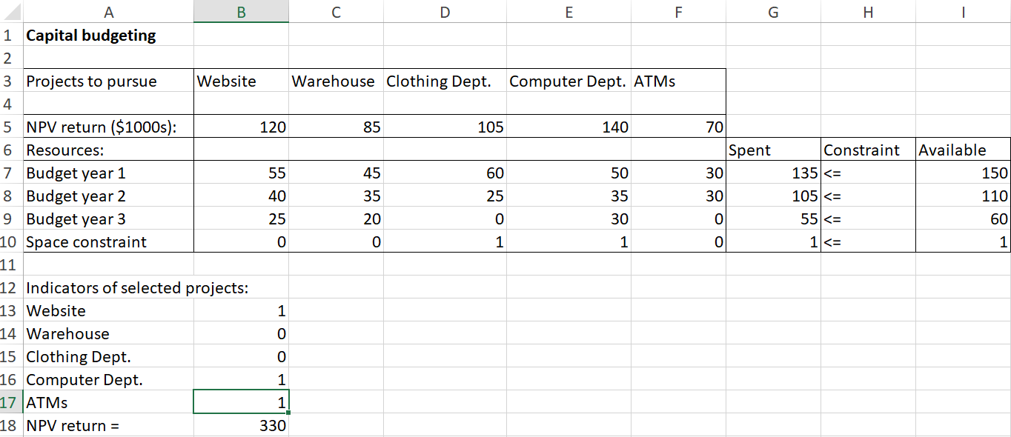
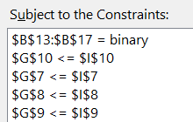
Ex: Capital Budgeting
Modifying constraints for binary decision variables

Slide 6
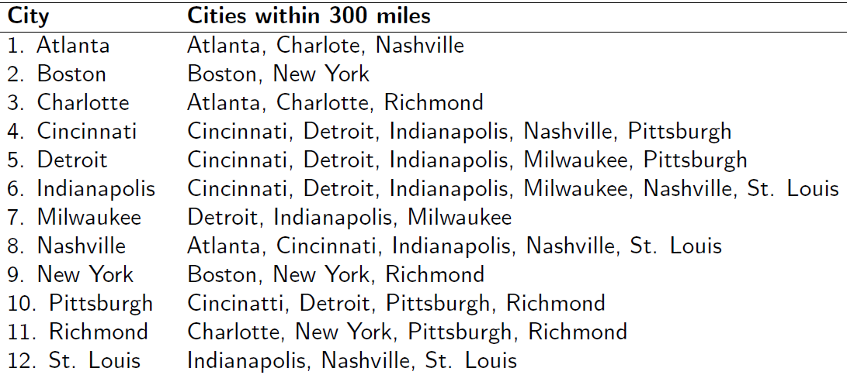
Ex: Set Covering
American Parcel Service (APS) has determined it needs to add several new package distribution hubs to service cities east of the Mississippi River
APS desires to construct the minimum set of new hubs in the following 12 cities so that there is a hub within 300 miles of each city

Slide 7
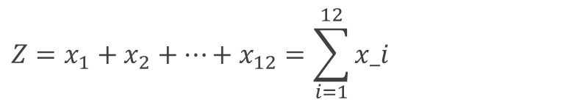
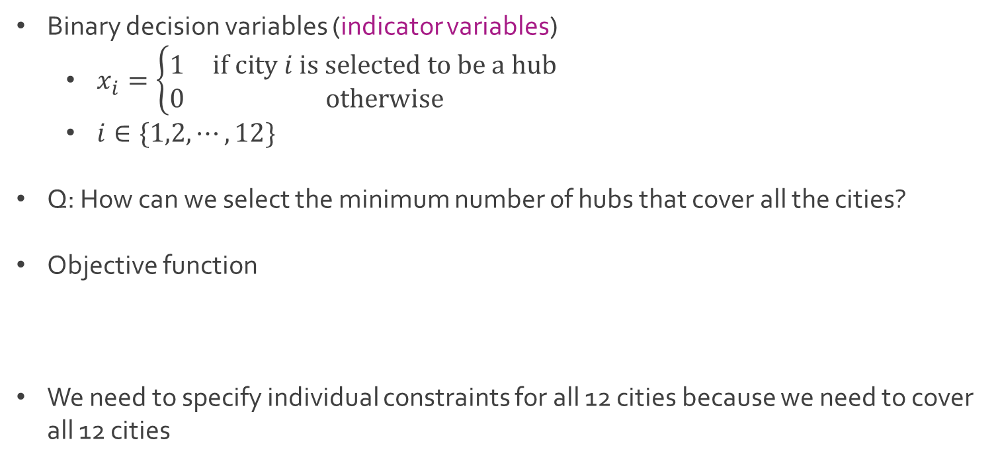
Ex: Set Covering
Binary decision variables (indicator variables)
$x_{i}=\left\{\begin{matrix}1 & if city i is selected to be a hub \\ 0 & otherwise\end{matrix}\right.$
$i∈\{1,2,⋯,12\}$
Q: How can we select the minimum number of hubs that cover all the cities?
Objective function
We need to specify individual constraints for all 12 cities because we need to cover all 12 cities
$$Z=x_{1}+x_{2}+⋯+x_{12}=\sum_{i=1}^{12}{x_i}$$

Slide 8
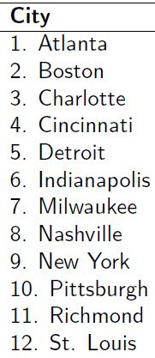
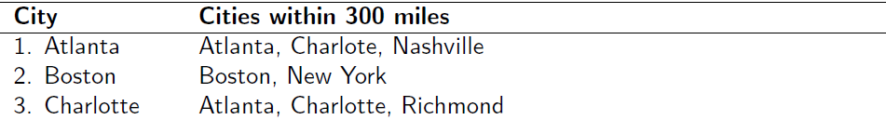
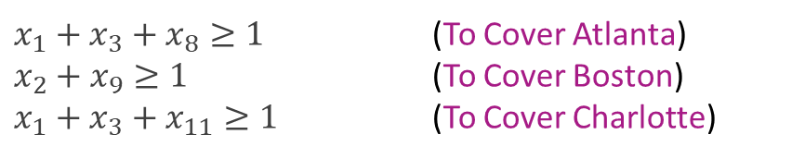
Ex: Set Covering
Constraints to ensure covering of first 3 cities
Download SetCovering.xlsx from course website from link Sheet 2
Run Excel Solver to find the solution
$x_{1}+x_{3}+x_{8}≥1$ (To Cover Atlanta)
$x_{2}+x_{9}≥1$ (To Cover Boston)
$x_{1}+x_{3}+x_{11}≥1$ (To Cover Charlotte)

Slide 9
Ex: Set Covering
Minimum number of distribution hubs needed is 4
Optimal solution given below with duplicate cities underlined
Other optimum solutions exist i.e. {Boston, Charlotte, Detroit, St. Louis}

Slide 10
Ex: Transporting Grain
General transportation problem
There are sources and destinations
Sources have supply and destinations have demand
A cost is associated to transport units along each route
Wheat is harvested in the Midwest and stored in grain elevators in 3 different cities
Kansas City
Omaha
Des Moines
These grain elevators supply flour mills in 3 different cities
Chicago
St. Louis
Cincinnati

Slide 11
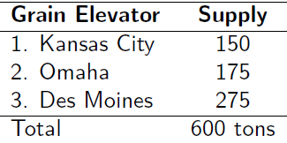
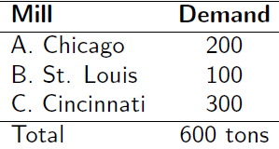
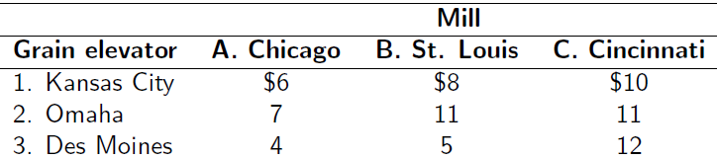
Ex: Transporting Grain
Supply and demand each month in tons
Grain is shipped in railroad cars, each capable of holding 1 ton of wheat
Transportation cost per ton (railroad car) of wheat

Slide 12
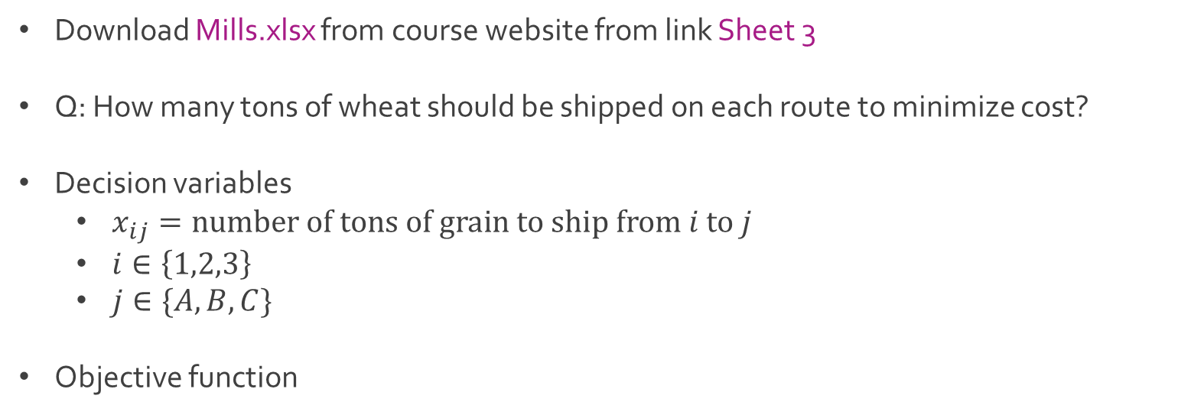
Ex: Transporting Grain
Download Mills.xlsx from course website from link Sheet 3
Q: How many tons of wheat should be shipped on each route to minimize cost?
Decision variables
$x_{ij}=number of tons of grain to ship from i to j$
$i∈\left\{1,2,3\right\}$
$j∈\{A,B,C\}$
Objective function
$Z=6x_{1A}+8x_{1B}+10x_{1C}+7x_{2A}+11x_{2B}+11x_{2C}+4x_{3A}+5x_{3B}+12x_{3C}$

Slide 13
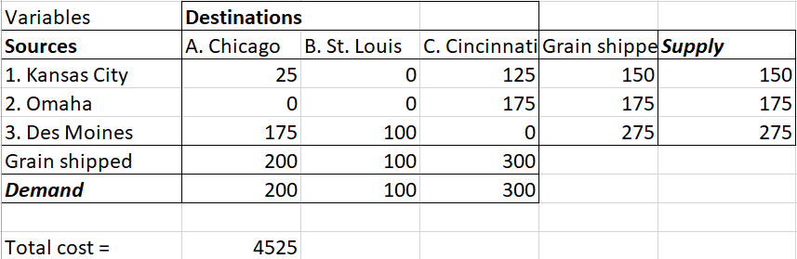

Ex: Transporting Grain
Constraints
Optimal solution
$x_{1A}+x_{1B}+x_{1C}=150$ (Kansas City Supply)
$x_{2A}+x_{2B}+x_{2C}=175$ (Omaha Supply)
$x_{3A}+x_{3B}+x_{3C}=275$ (Des Moines Supply)
$x_{1A}+x_{2A}+x_{3A}=200$ (Chicago Demand)
$x_{1B}+x_{2B}+x_{3B}=100$ (St. Louis Demand)
$x_{1C}+x_{2C}+x_{3C}=300$ (Cincinnati Demand)
$$x_{ij}∈\{0,1,2,⋯\}$$

Slide 14
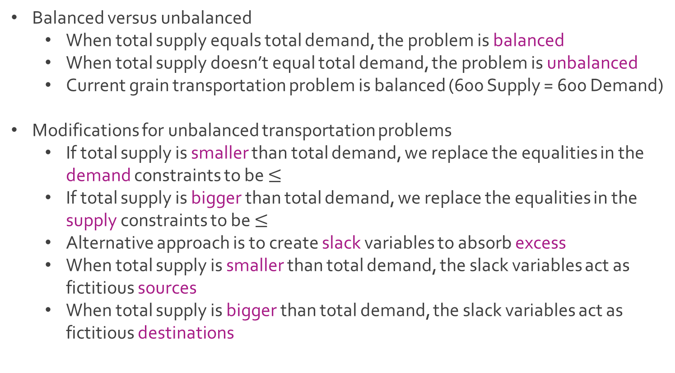
Ex: Transporting Grain
Balanced versus unbalanced
When total supply equals total demand, the problem is balanced
When total supply doesn’t equal total demand, the problem is unbalanced
Current grain transportation problem is balanced (600 Supply = 600 Demand)
Modifications for unbalanced transportation problems
If total supply is smaller than total demand, we replace the equalities in the demand constraints to be $≤$
If total supply is bigger than total demand, we replace the equalities in the supply constraints to be $≤$
Alternative approach is to create slack variables to absorb excess
When total supply is smaller than total demand, the slack variables act as fictitious sources
When total supply is bigger than total demand, the slack variables act as fictitious destinations

Slide 15

Ex: Transporting Grain
Suppose we change Cinicinnati’s demand from 300 to 350
New constraints
Total supply (600) is smaller than total demand (650)
$x_{1A}+x_{1B}+x_{1C}=150$ (Kansas City Supply)
$x_{2A}+x_{2B}+x_{2C}=175$ (Omaha Supply)
$x_{3A}+x_{3B}+x_{3C}=275$ (Des Moines Supply)
$x_{1A}+x_{2A}+x_{3A}≤200$ (Chicago Demand)
$x_{1B}+x_{2B}+x_{3B}≤100$ (St. Louis Demand)
$x_{1C}+x_{2C}+x_{3C}≤350$ (Cincinnati Demand)
$$x_{ij}∈\{0,1,2,⋯\}$$

Slide 16

Ex: Transporting Grain
Include fictitious source “Slack (S)”
Modified constraints with slack variable
$x_{1A}+x_{1B}+x_{1C}=150$ (Kansas City Supply)
$x_{2A}+x_{2B}+x_{2C}=175$ (Omaha Supply)
$x_{3A}+x_{3B}+x_{3C}=275$ (Des Moines Supply)
$x_{SA}+x_{SB}+x_{SC}=50$ (Fictitious “Slack” Supply)
$x_{1A}+x_{2A}+x_{3A}+x_{SA}=200$ (Chicago Demand)
$x_{1B}+x_{2B}+x_{3B}+x_{SB}=100$ (St. Louis Demand)
$x_{1C}+x_{2C}+x_{3C}+x_{SC}=350$ (Cincinnati Demand)
$$x_{ij}∈\{0,1,2,⋯\}$$

Slide 17
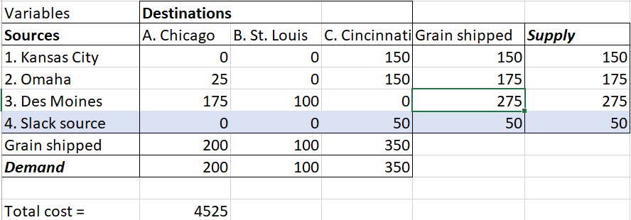
Ex: Transporting Grain
Optimal solution from Solver
Q: Why is all the grain from slack going to Cincinnati?

Slide 18




The End
Dale

